Slide 1
MULTI NODE CLUSTER SETUP
PROJECT TITLE
Using
Apache Spark

Slide 2
What will we learn today???
History of Apache Spark
Definition of Apache Spark
Supported Languages
Purposes for learning Apache Spark
Alternative of Apache Spark
Spark Features
Components of Apache Spark

Slide 3

Spark Architecture
Spark Cluster Managers
Applications Of Spark
Spark Use Case
Summary

Slide 4
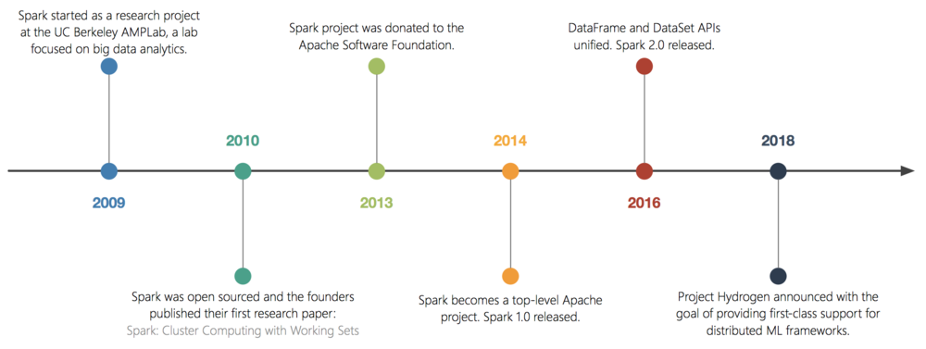
History of Apache Spark

Slide 5
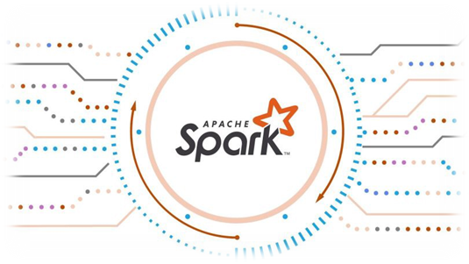
What is Apache Spark???
Open source data processing engine
Stores and Processes data in real time
Creates various clusters
Using a very simple programming constructs.

Slide 6
Supported Languages
R
Python
Java
Scala

Slide 7
Purposes of Apache Spark
Big Data Analysis
Query, Analyze and Transform Data
Performs both batch & real-time processing
Fewer lines of code
Faster than Map Reduces
Developers and Data Scientists incorporate Spark in to their apps

Slide 8
Alternative of Apache Spark
Hadoop
Apache Strom
Data torrent
Hadoop
Using map reduce
Performs batch processing
More lines code
Takes more time to execute
Apache Strom
Unbounded sequence of tuples
open-source real-time solution
Micro batch and stream processing
Data Torrent
Stream processing platform
Using VPN services , becomes a risky business
Malware Risks

Slide 9
Apache Spark Features
Fast Processing
In Memory Computing
Flexible
Fault Tolerance
Better Analytics

Slide 10
Components of Apache Spark
Spark Core
Spark SQL
Spark Streaming
ML lib
Graph X

Slide 11
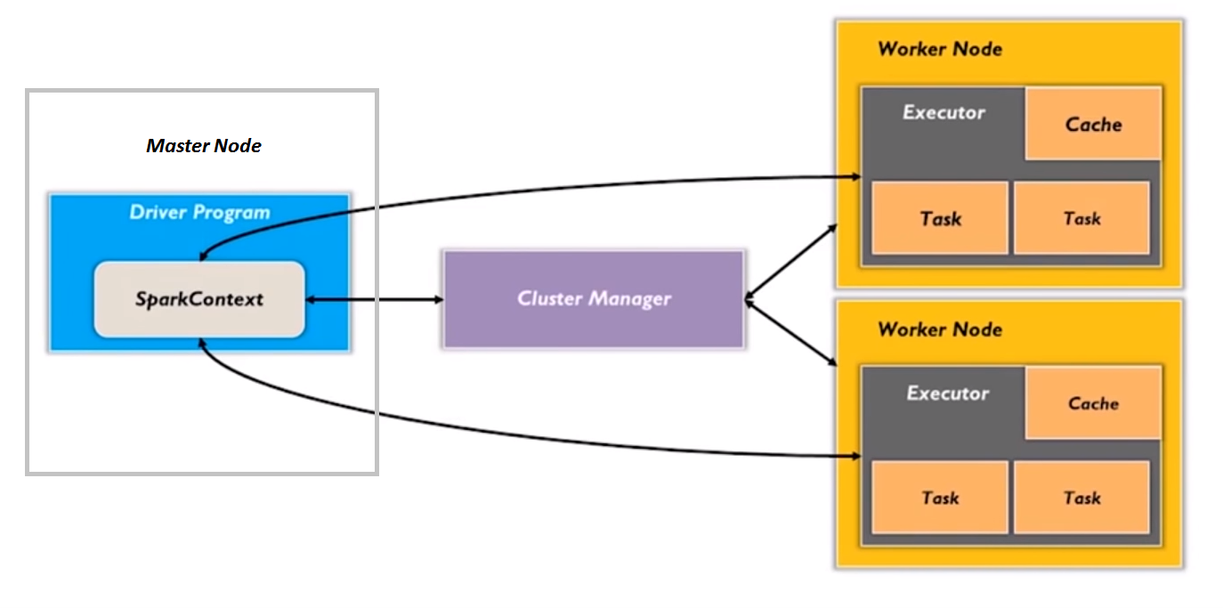
Spark Architecture

Slide 12
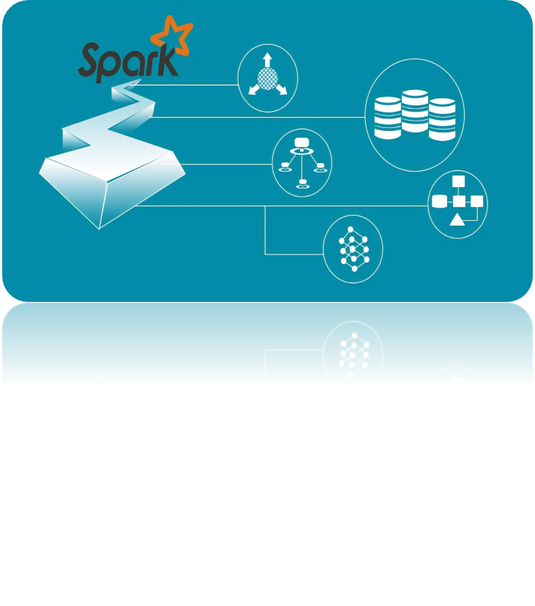
Spark Cluster Managers
Standalone Mode
Mesos
Hadoop YARN
Kubernetes

Slide 13

Applications of Spark
*Banking
JP MORGAN GHASE & Co.
Fraud Transactions and Acc. Holders..
*Entertainment
Netflix & RIOT Game
Showcase relevant advertise
*Healthcare
IQVIA
Analyze patient’s Data & Identify Diseases.
*E-Commerce
Alibaba Group
Big Data Analysis

Slide 14

Spark Use Case
Con viva:
a. Video Streaming
b. Remove Screen Buffering
c. Helps to give better quality
d. Collects data & Give their Customers Visibility

Slide 15
Summary
Apache Spark has its architectural foundation in the resilient distributed dataset (RDD), a read-only multiset of data items distributed over a cluster of machines, that is maintained in a fault-tolerant way.

Slide 16

ANY QS
???

